Slide 1
Audit 4.0-based ESG Assurance: An Example of Using Satellite Images on GHG Emissions
Yu Gu¹
Jun Dai²
Miklos A. Vasarhelyi¹
¹ Rutgers, The State University of New Jersey
² Michigan Technological University
51st World Continuous Auditing & Reporting Symposium

Slide 2
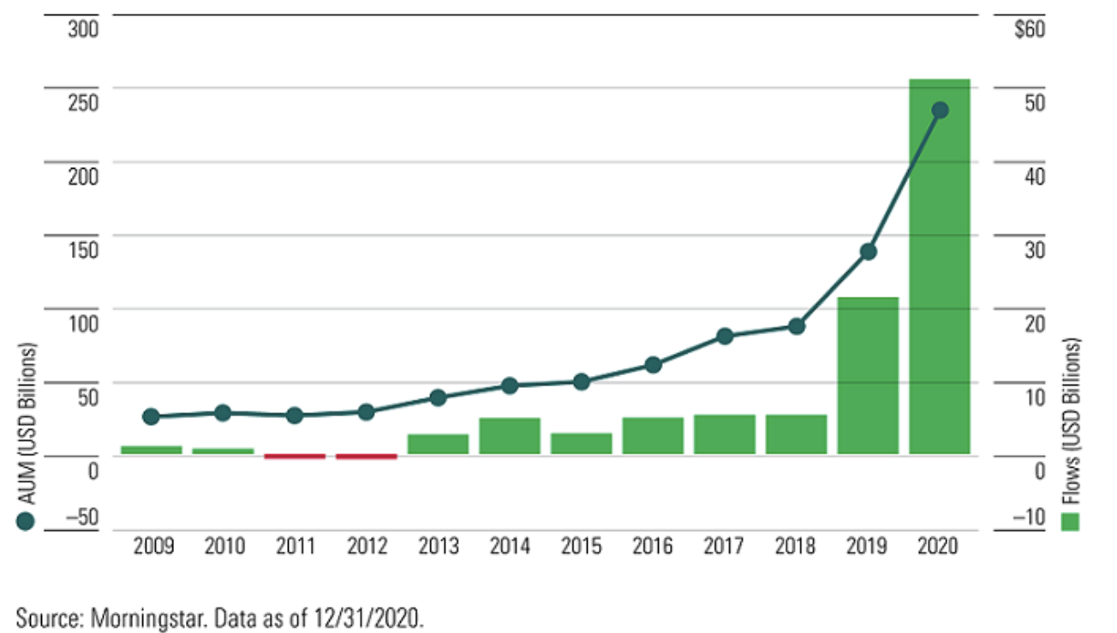
Motivation
Company
90% of S&P 500 Index companies publish ESG reports in 2019 (G&A, 2020).
Sustainability investment has increased drastically.
Company
Regulator
Investor
ESG Reports
Figure 1. Sustainable Funds Annual Flows and Assets

Slide 3
Motivation
Regulator
Company
Regulator
Investor
ESG Reports

Slide 4
Motivation
Company
Regulator
Investor
Only 51% ESG information is assured (AICPA IFAC CIMA 2021)
Key challenges in existing audit standards (ISAE 3000; AA1000AS)
ESG Reports
ESG Assurance

Slide 5
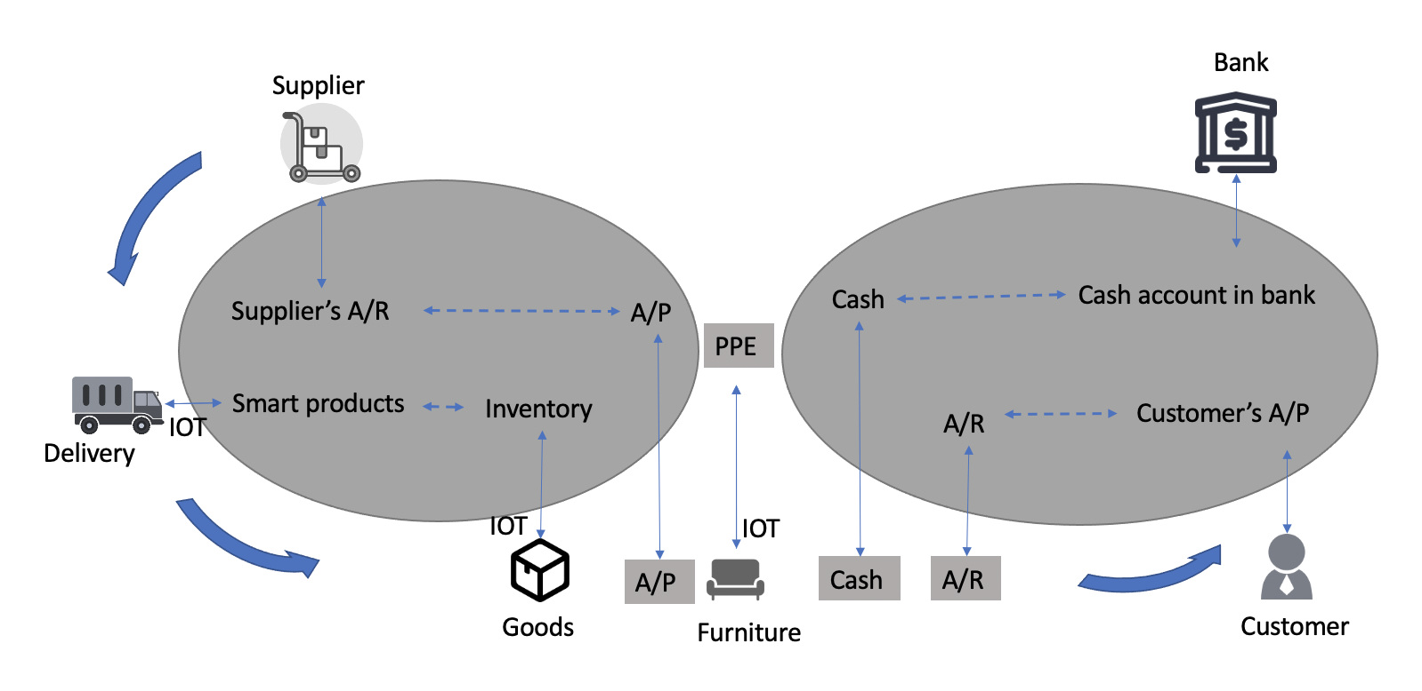
Motivation
Company
Regulator
Investor
Only 51% ESG information is assured
Key challenge in existing audit standards
Big data
Audit 4.0
ESG Reports
ESG Assurance
Emerging Technology
Figure 2. An overview of Audit 4.0
(adapted from Dai and Vasarhelyi, 2016)

Slide 6
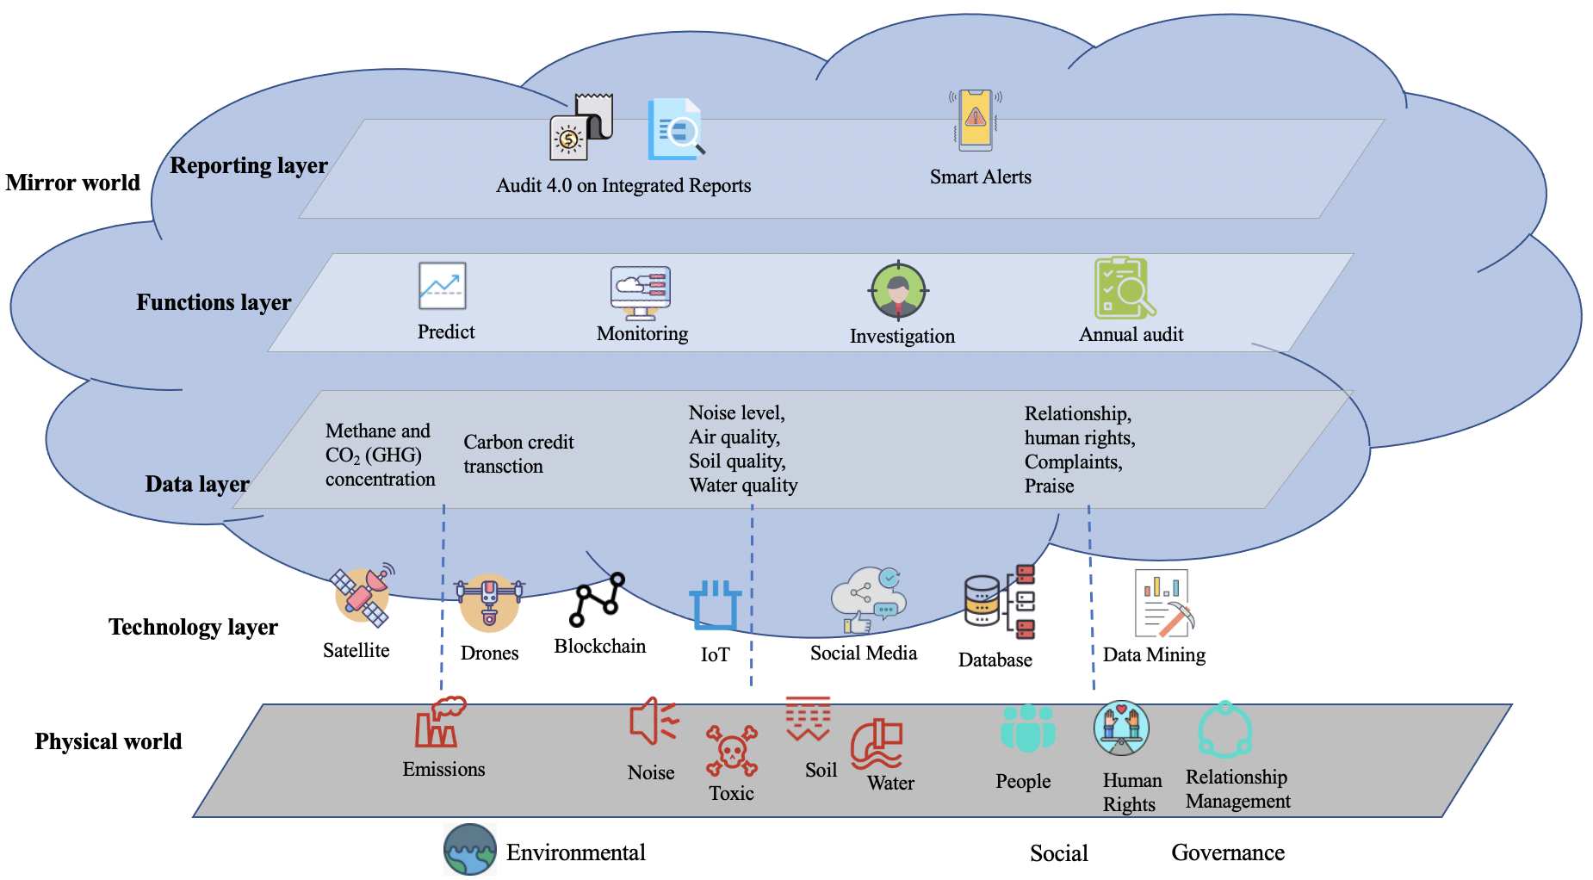
Design of Audit 4.0 on ESG
Figure 3. Design of Audit 4.0 on ESG

Slide 7
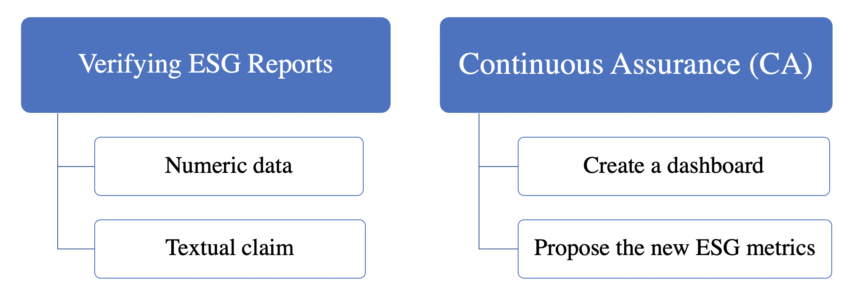
Objectives for the Audit 4.0-based ESG

Slide 8
Numeric data: BP ESG Reports - Datasheet - Yearly

Slide 9
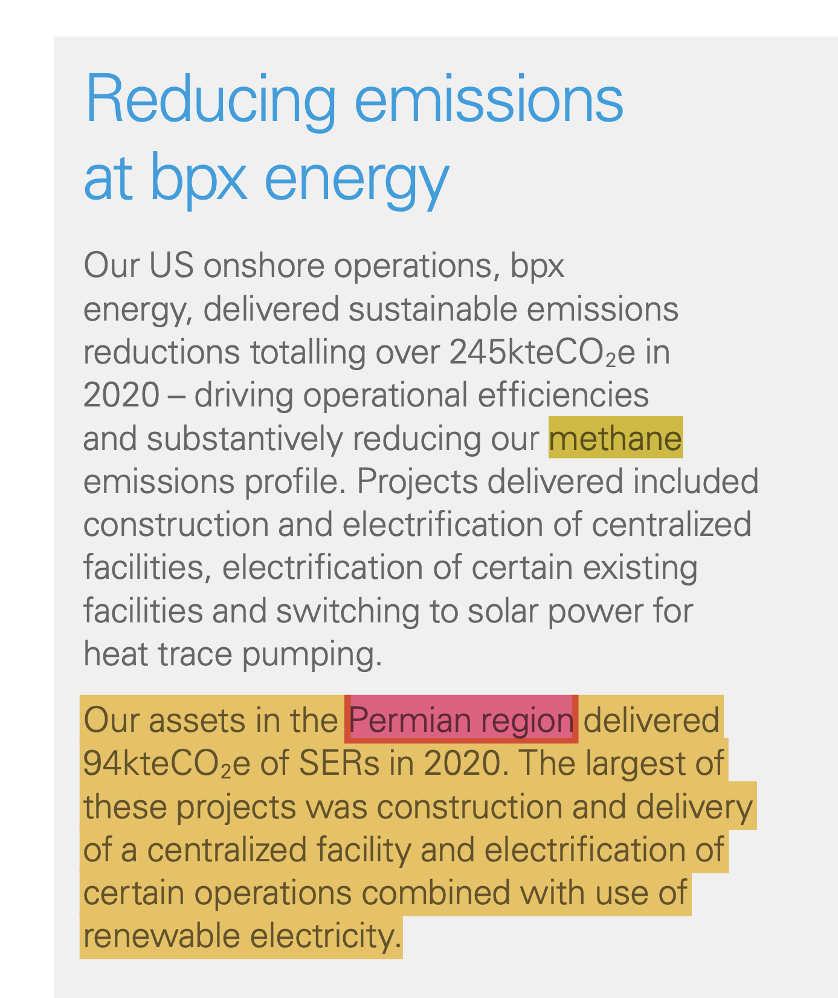
Textual claim
bpx energy’s new electric substation located at the ‘Grand Slam’ facility in Orla Texas became operational in 2020.

Slide 10
Verifying process
External
Internal

Slide 11
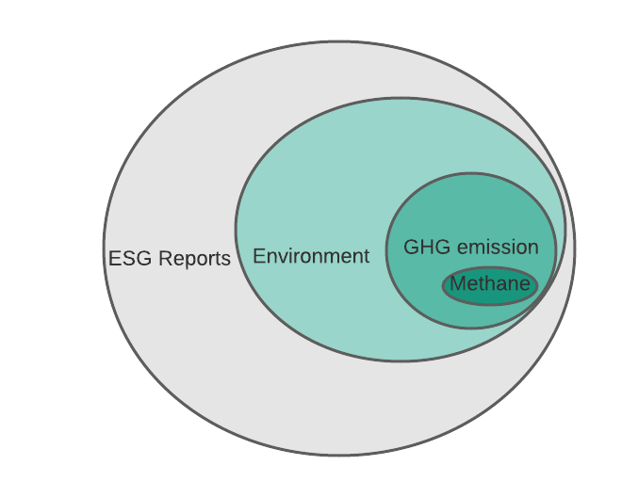
Case Study - Methane - Satellite Images
Two methods to report GHG emissions
Accounting method
Continuous monitoring method
uses a statistical way to calculate the emission from the revised estimates by the default emission factors for combustion for each energy product type from the list of emission factors.
uses the sensors in the vent system to monitor real-time emissions.
The calculation is based on the fuel consumption.
In 2015, Volkswagen was accused of using illegal software to cover up excessive emissions by the U.S. Environmental Protection Agency.

Slide 12
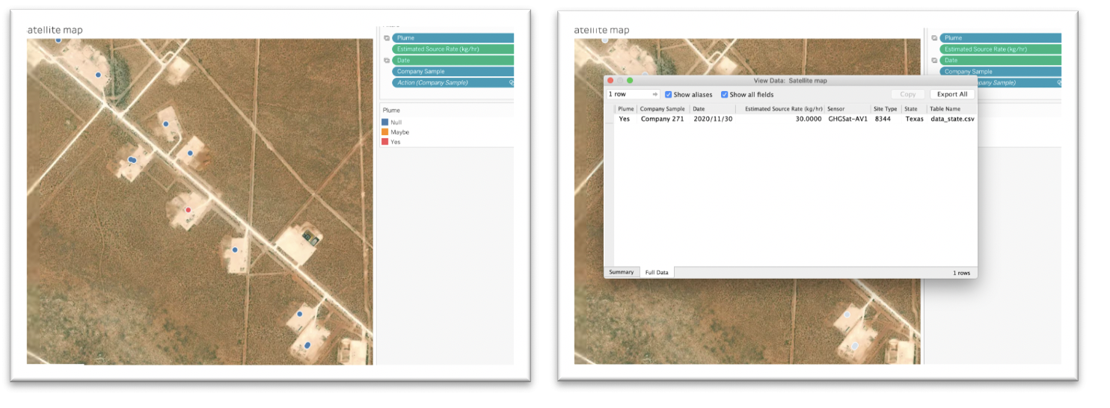
Case study - Analysis (Dashboard) - in Tableau
Figure 4. Satellite map

Slide 13
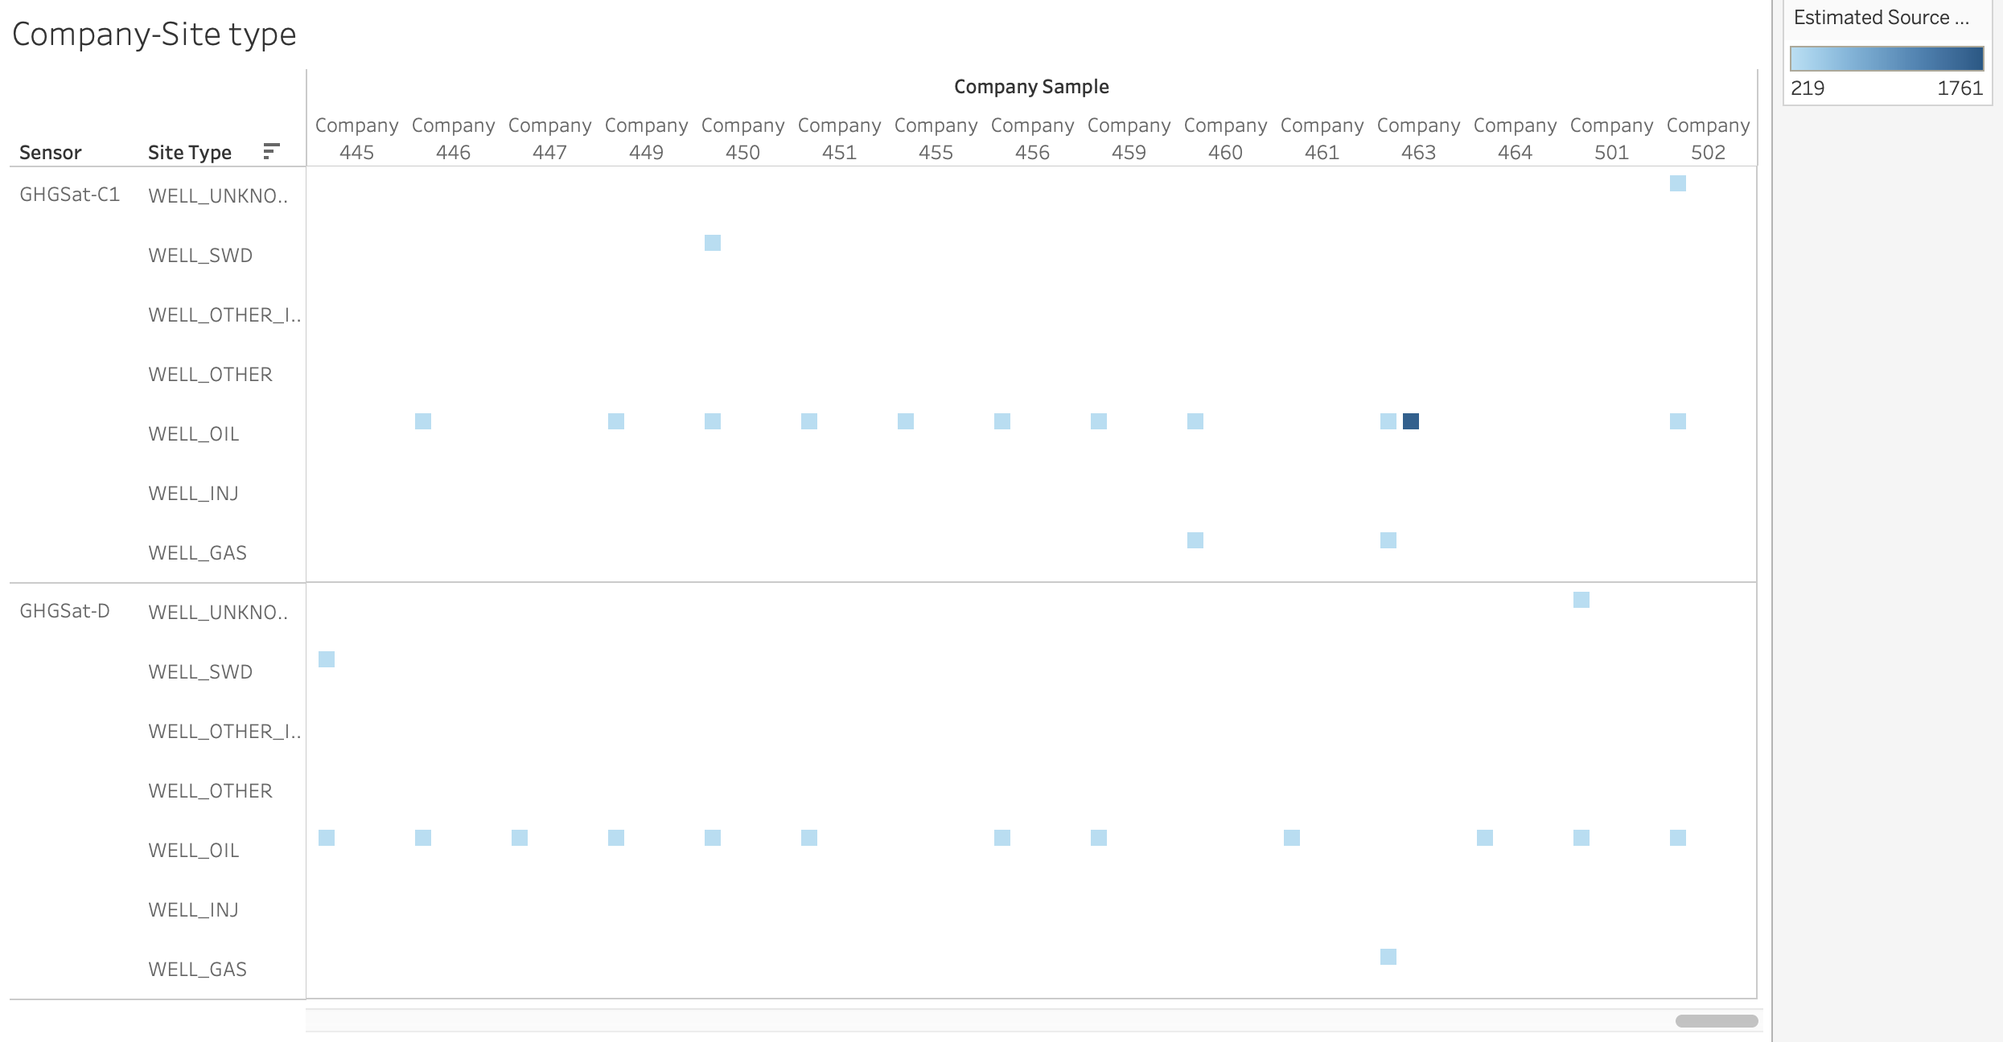
Case study - Analysis (Dashboard) - in Tableau
Figure 5. Company – Site type

Slide 14
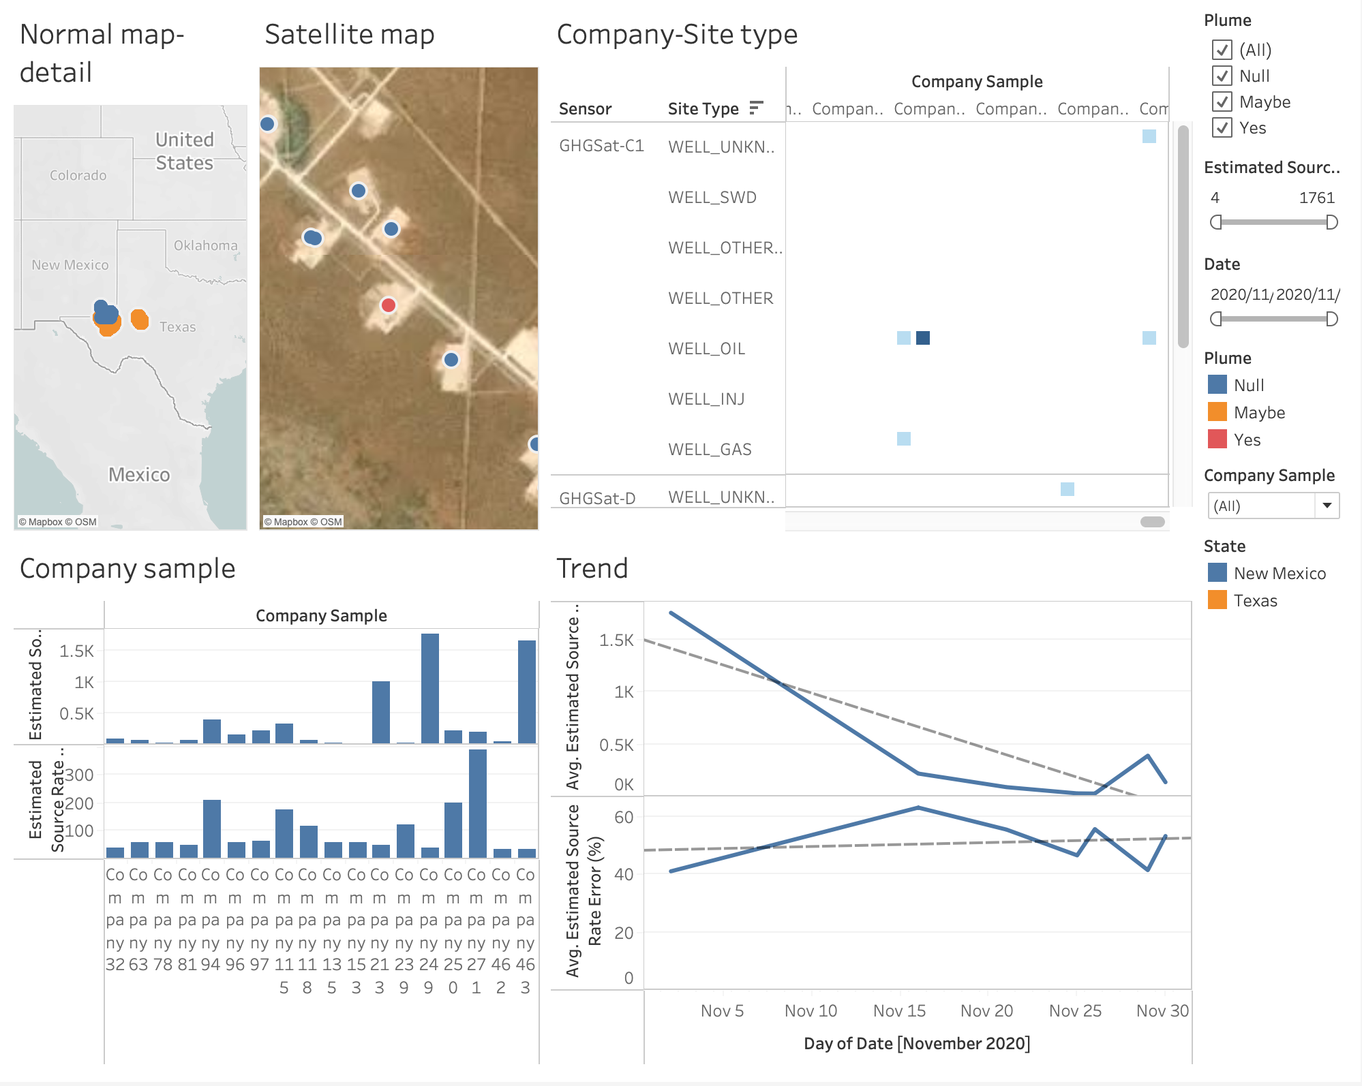
Case study - Analysis (Dashboard) - in Tableau
Figure 6. Dashboard AVG (Estimated Source Rate)-Date

Slide 15
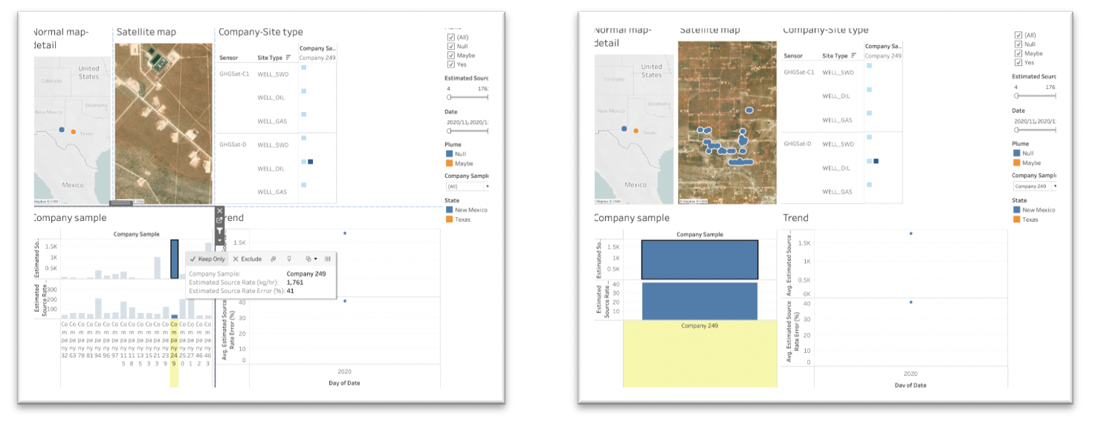
Case study - Analysis (Dashboard) - in Tableau
Figure 7. Interactive functions

Slide 16
Contribution
Explore ESG assurance for new exogenous ESG metrics
Echo the Center for Audit Quality (CAQ, 2021)’s call for researching attestation on non-financial information
Pioneer the use of satellite images to provide assurance

Slide 17
Limitation
Accuracy of data
Not real-time
Take pictures in the day
Emission strategy
A proof of concept
Invite detailed cost-benefit analyses
Weather (cloudy) and wind
Due to the maturity of the required technologies

Slide 18
Thank you!
Contact me: yu.gu431@rutgers.edu

